Slide 1

Subject : Mini Project - COM-612
Intrusion Detection in Home Automation Using Computer Vision and Honeypots
Project Name : Chakravyuh
Project Description : A state of the art Intrusion Detection Framework that secures network
as well as parameter by using honeypot technology and computer vision integrated into a centralized
smart notification IOT system.
Team Leader : Aadhaar Koul (2020a1r040) - CSE
Team Member 1 : Arjun Charak (2020a1r058) - CSE
Team Member 2 : Baseer Fatima (2020a1r045) - CSE
Team Member 3 : Novneet Kour (2020a1r048) - CSE

Slide 2
Contents
Problem
Global Landscape
Proposed Solution
Tech Stack
Framework
Workflow
Product / Modules
Demonstration

Slide 3
Problem
Cyber crime now a days is booming at an alarming rate. The Nieveness and the lack of awareness among the users has increased the rate of cyber crime by a large number. The Most common attacks to which the users are most succeptible are the phishing and the MITM(Man In The Middle Attacks) that are usually carried out on the free public wifi’s and home gateways.
Problem 1
People dont really care about their online activities and the cyber crimes untill they encounter one.
Problem 2
Users dont have access to the heavy hardware and software to protect themselves in the online jungle.
Problem 3
There are different kinds of cyber attack techniques and no one stop solution.

Slide 4
Global Cyber Landscape
Global Cost
An estimate of about 10.5 Trillion Dollars is the round figure that cyber frauds are going to cost the world in the coming years.
Accessibility
Only the Big Data companies and large scale industries use advance methods and protocols to detect and deal with a cyber crime.
Emerging Trends
With the advancements in technology and security measures , the hackers are also evolving and developing better and stealthier malwares.

Slide 5
Solution 1
Development of an advanced intrusion detection networking system, automation, and notification system using the latest Computer Vision and Honeypot technology.
Solution 2
Creating a hardware and software solution that accurately classifies the level of intrusion in a premises or Local Area Network/Wide Area Network.
Solution
One stop Intrusion Detection System
Solution 3
Design and implementing an IoT-based locking system that prevents unauthorized access to the property using Computer Vision and Neural Networks framework.
Solution 4
Making the solution availbale to a common man by using low cost , efficient hardware that provides the same set of functionalities that of a large scale IDS.

Slide 6

















TECH STACK
Framework
Ai / ML / CV
Frontend / Interface
Backend
Cloud
IOT
Hosting
Operating System

Slide 7
LANGUAGES
For Django App Deployment
and database
For Django app deployment and , dashboard development
For IOT and centralized smart notification system
For Android App Development and integrations
For Django deployment and , dashboard development
For Android App Interfaces
For web portal interfaces

Slide 8
FRAMEWORK
IP survellance camera
Ultrasonics
Laser sensors
Network Sniffer
Honeypot Systems
Motion Sensors
PIR Sensors
VPN
Detection Sensors
Home Security system
Smart Notification System
wifi
Door Lock
Network and home automation Control platform
Admin control application
Arduino
Home Gateway
Media Server
Appliances
Appliances
WWW
TV
Storage

Slide 9
WORKFLOW
User turns on the IDS
Keep True
Honeypots , Notification systems , Detection sensors , Network Sniffers , and the web app portals are configured and turned on.
NO
Intrusion
Detected
NO
NO
YES
Tables and databases
Updated
Admin blocks
the intruder / Enables security protocols
Admin takes necessary actions
YES
YES
Intruder information saved via honeypots
Smart Notification
System sends alerts and advisory messages to the admin
All Systems lockdown,
Intruder Blocked from
entering the system

Slide 10

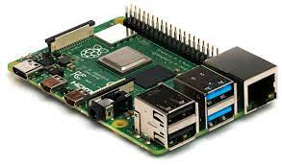
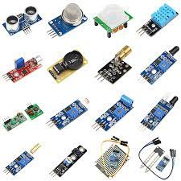
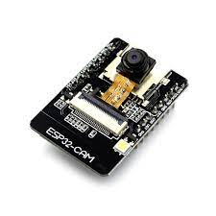
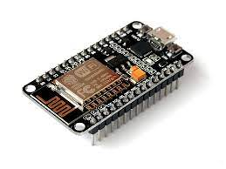
HARDWARE COMPOENTS
Micro Computers
Micro Controllers
Raspberry Pi 4 Model B
Arduino UNO
Sensors
Wifi Module
Camera Module
ESP 8266
ESP 32 CAM

Slide 11
PRODUCT MODULES
Network Gateway Module
Honeypot Module
IOT Modules
Blynk Cloud Module
Computer Vision Module
Survelliance Module
Android App Module

Slide 12
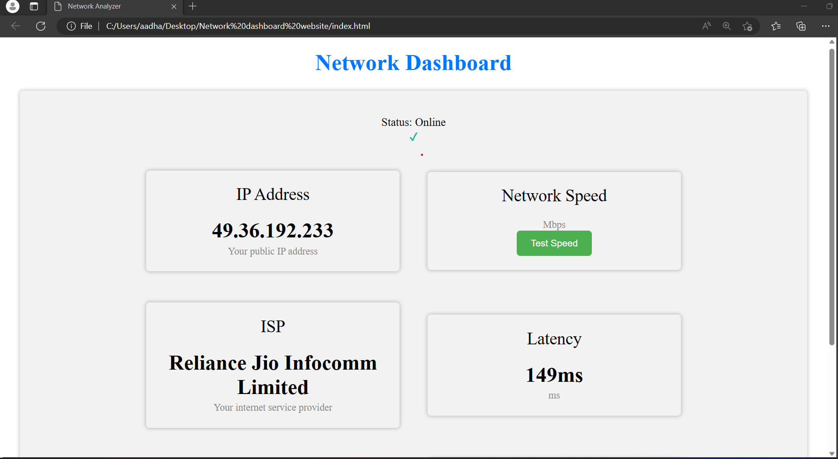

NETWORK GATEWAY DASHBOARD
Features
* Login functionality
* Network IP
* Network Speed
* ISP
* Network Latency
* Router’s IP
* DNS IP
* Apache2 Network Load Balancing
Test it Out on your device:

Slide 13
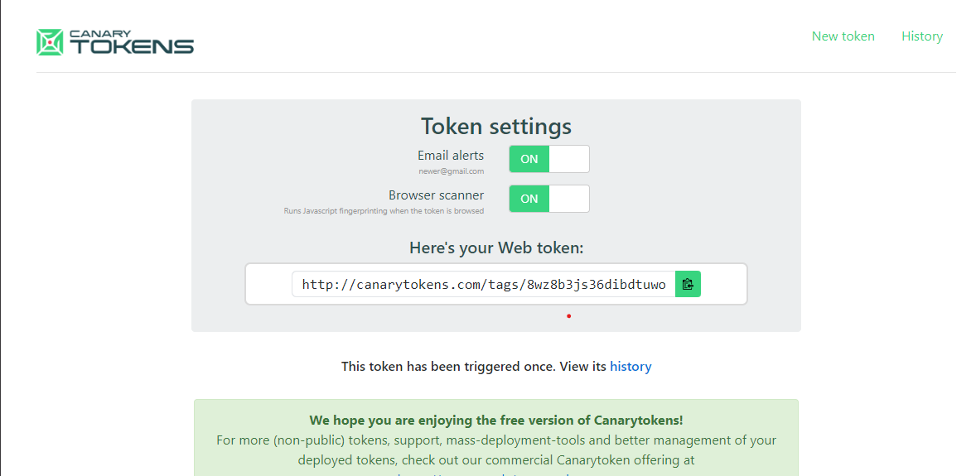
HONEYPOT SYSTEM

Slide 14
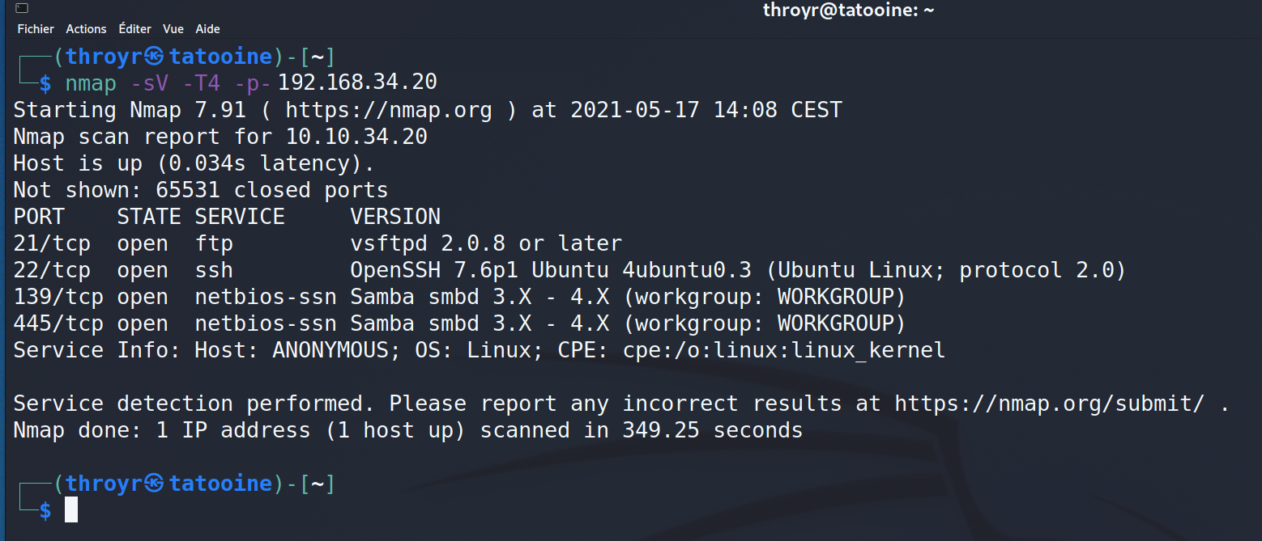
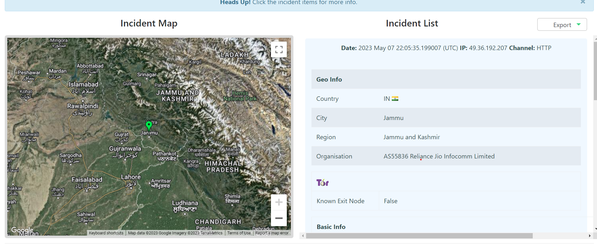
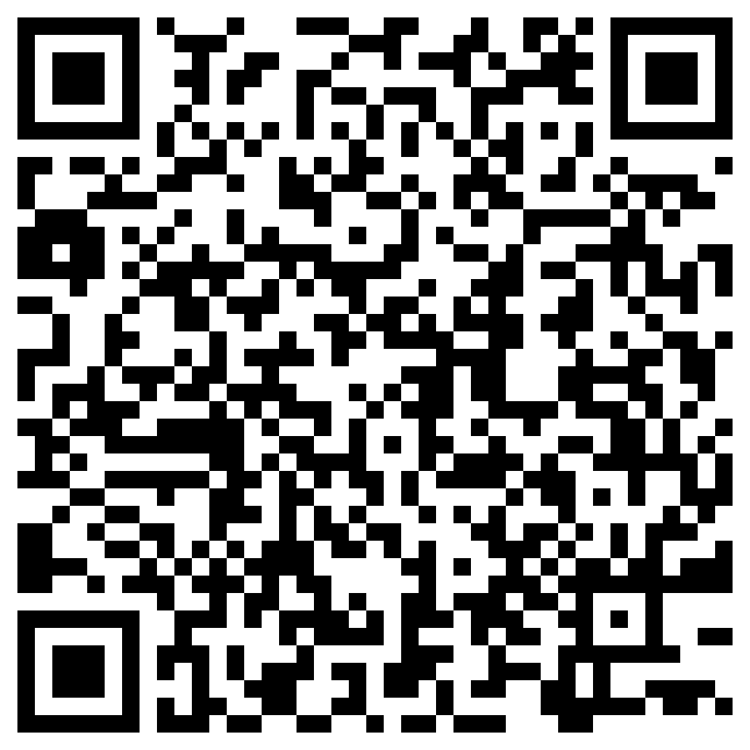
Features
* Decoy Vulnerable FTP server
* Flag based Tracking
* Type of attack vector identification
* Attack vector Location
* Attacker IP address
* Realtime network monitoring
Test it Out on your device:

Slide 15
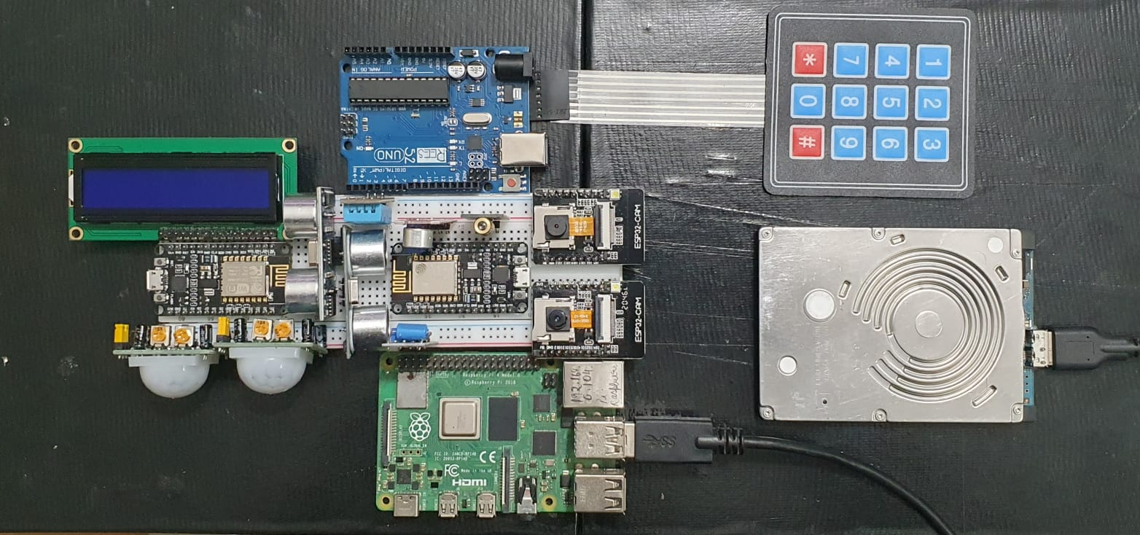
IOT MODULES
Features
* Cheap , Sustinable hardware
* Modular
*
Test it Out on your device:

Slide 16
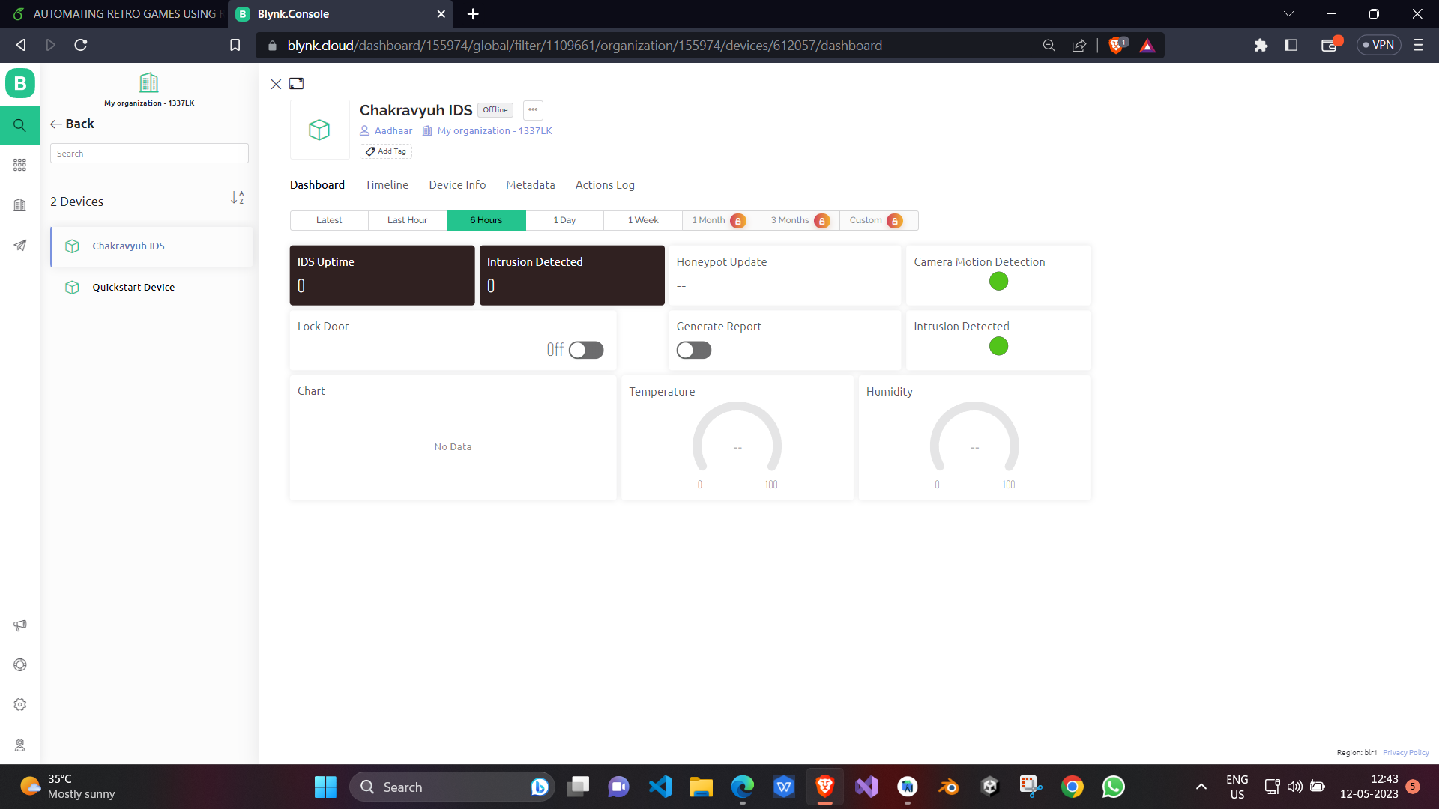
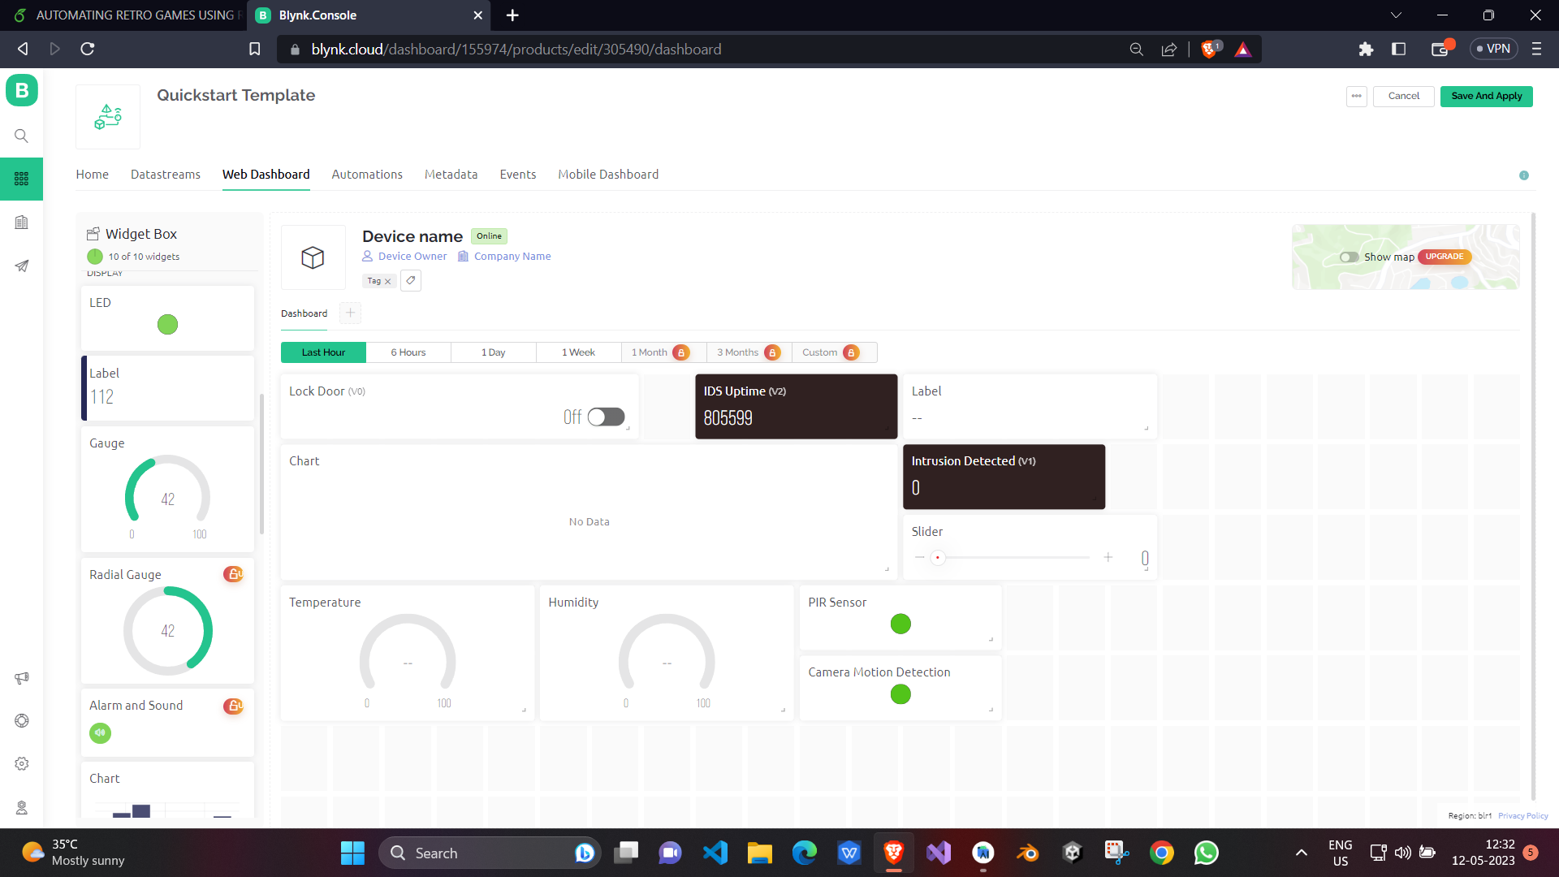
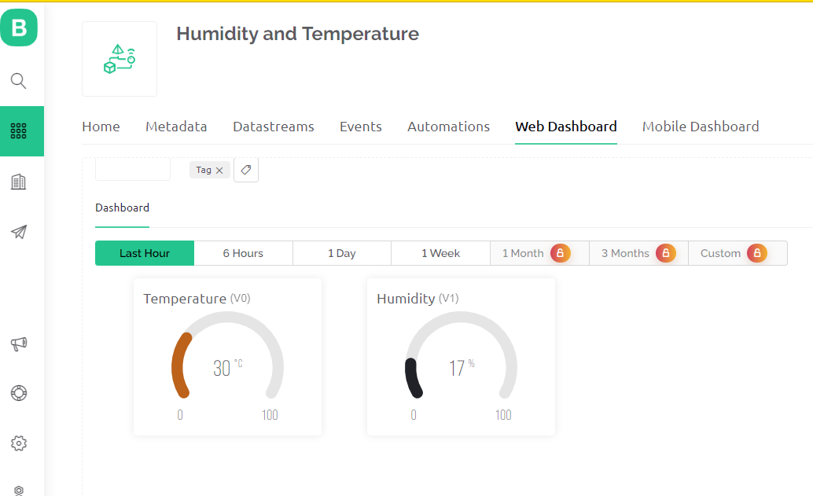
BLYNK CLOUD DASHBOARD
Features
* Real time sensor readings
* Seamless UI
* Integratable API Key
* Mobile and Web based platforms availble
* Drag and Drop Modular / admin dashboard
* Receive real time push and email notifications.
* Modular
Test it Out on your device:

Slide 17
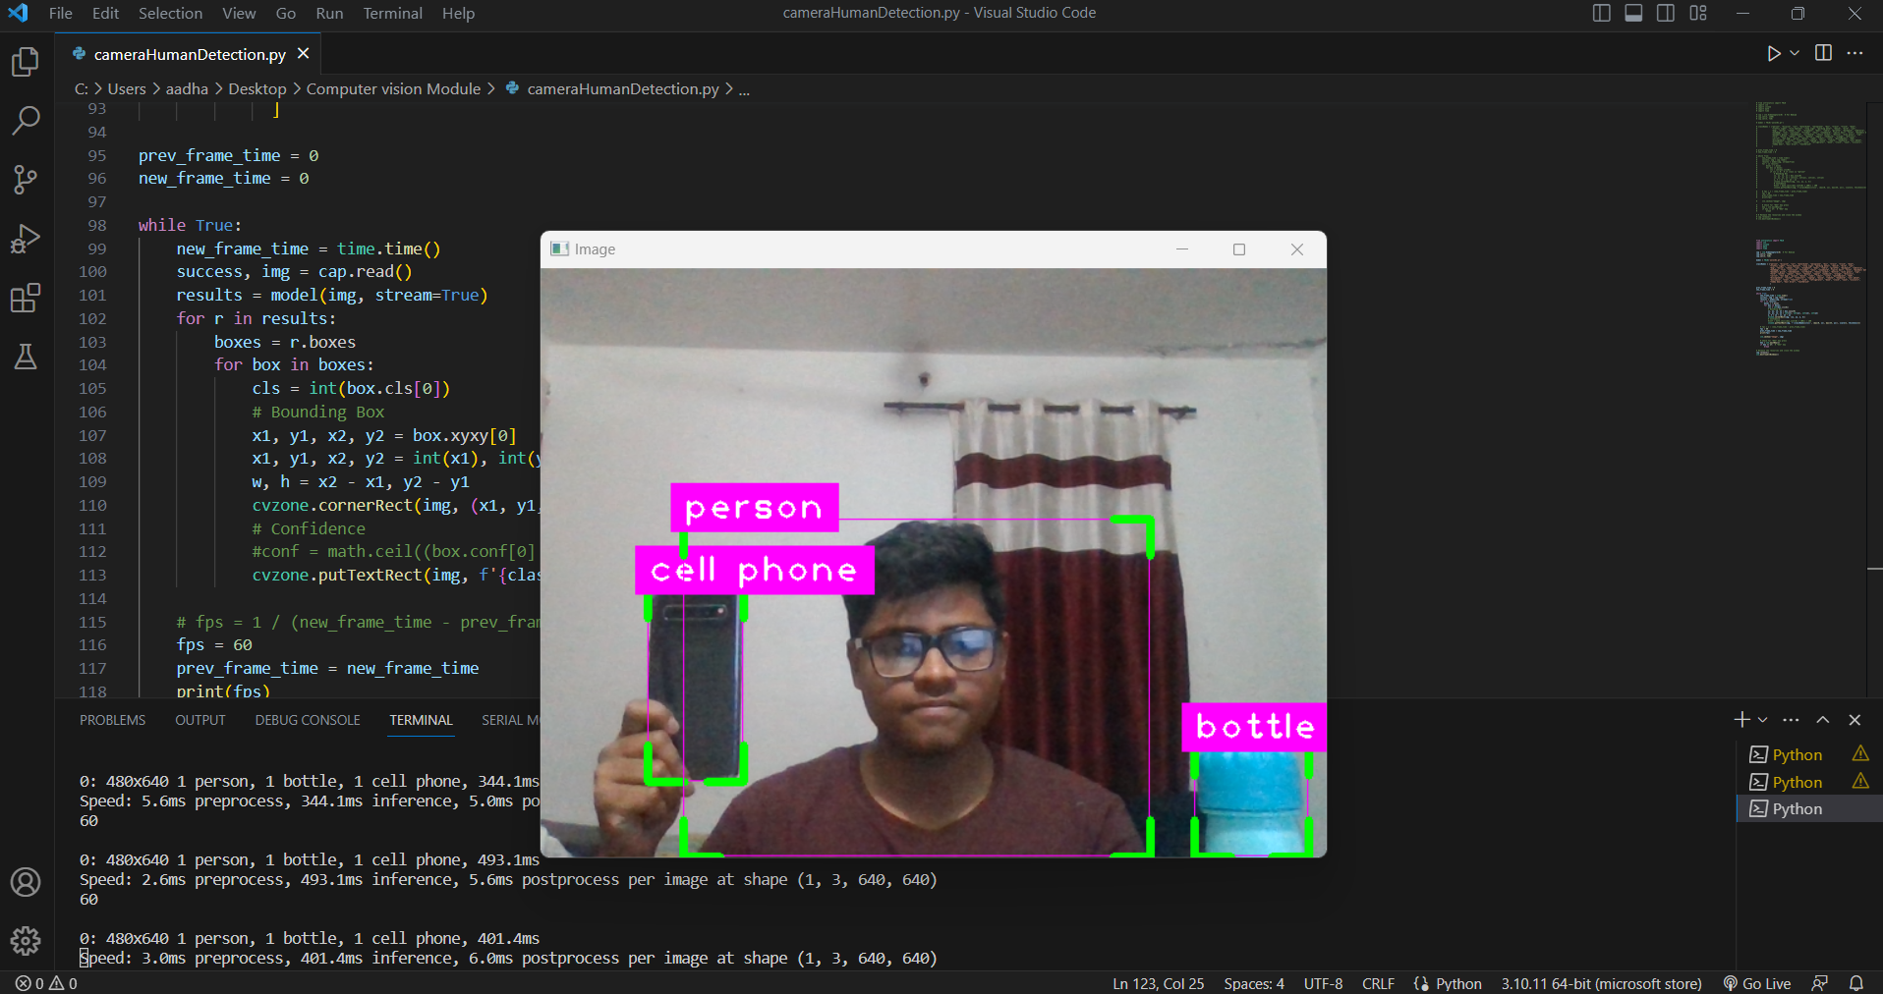
COMPUTER VISION MODULE
Features
* Login functionality
* Network IP
* Network Speed
* ISP
* Network Latency
* Router’s IP
* DNS IP
* Apache2 Network Load Balancing
Test it Out on your device:

Slide 18
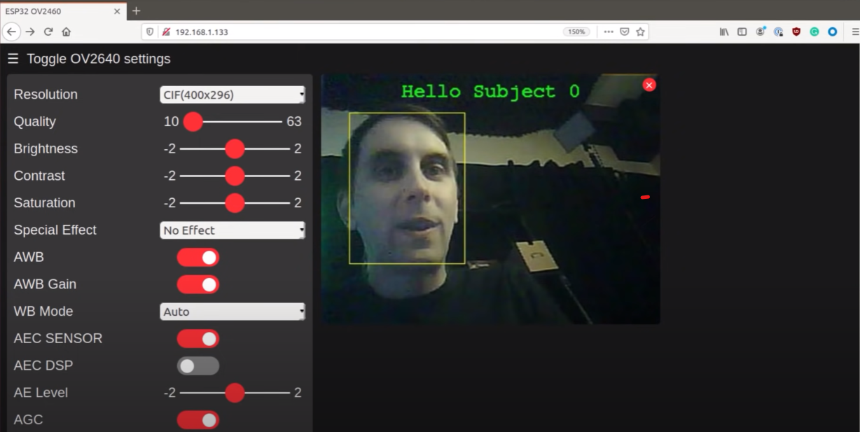
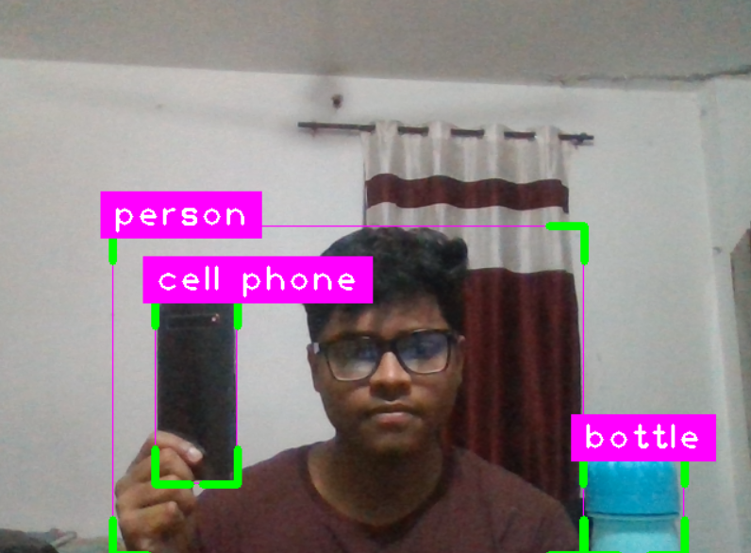
SURVEILLANCE DASHBOARD
Features
* Login functionality
* Network IP
* Network Speed
* ISP
* Network Latency
* Router’s IP
* DNS IP
* Apache2 Network Load Balancing
Test it Out on your device:

Slide 19
Traction

Slide 20
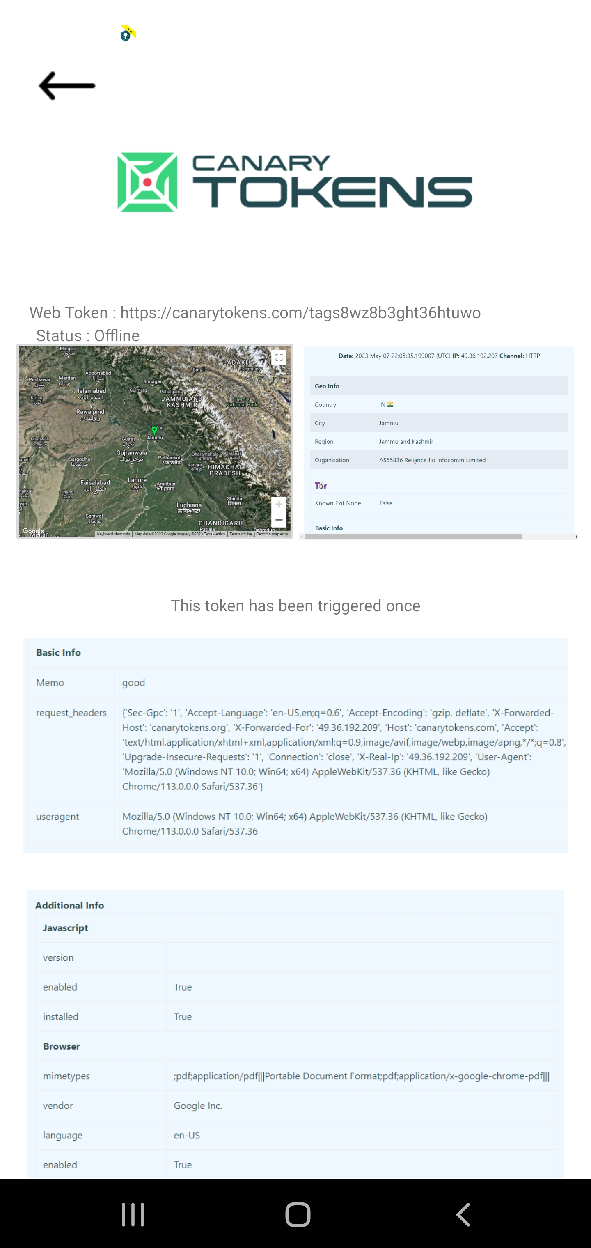
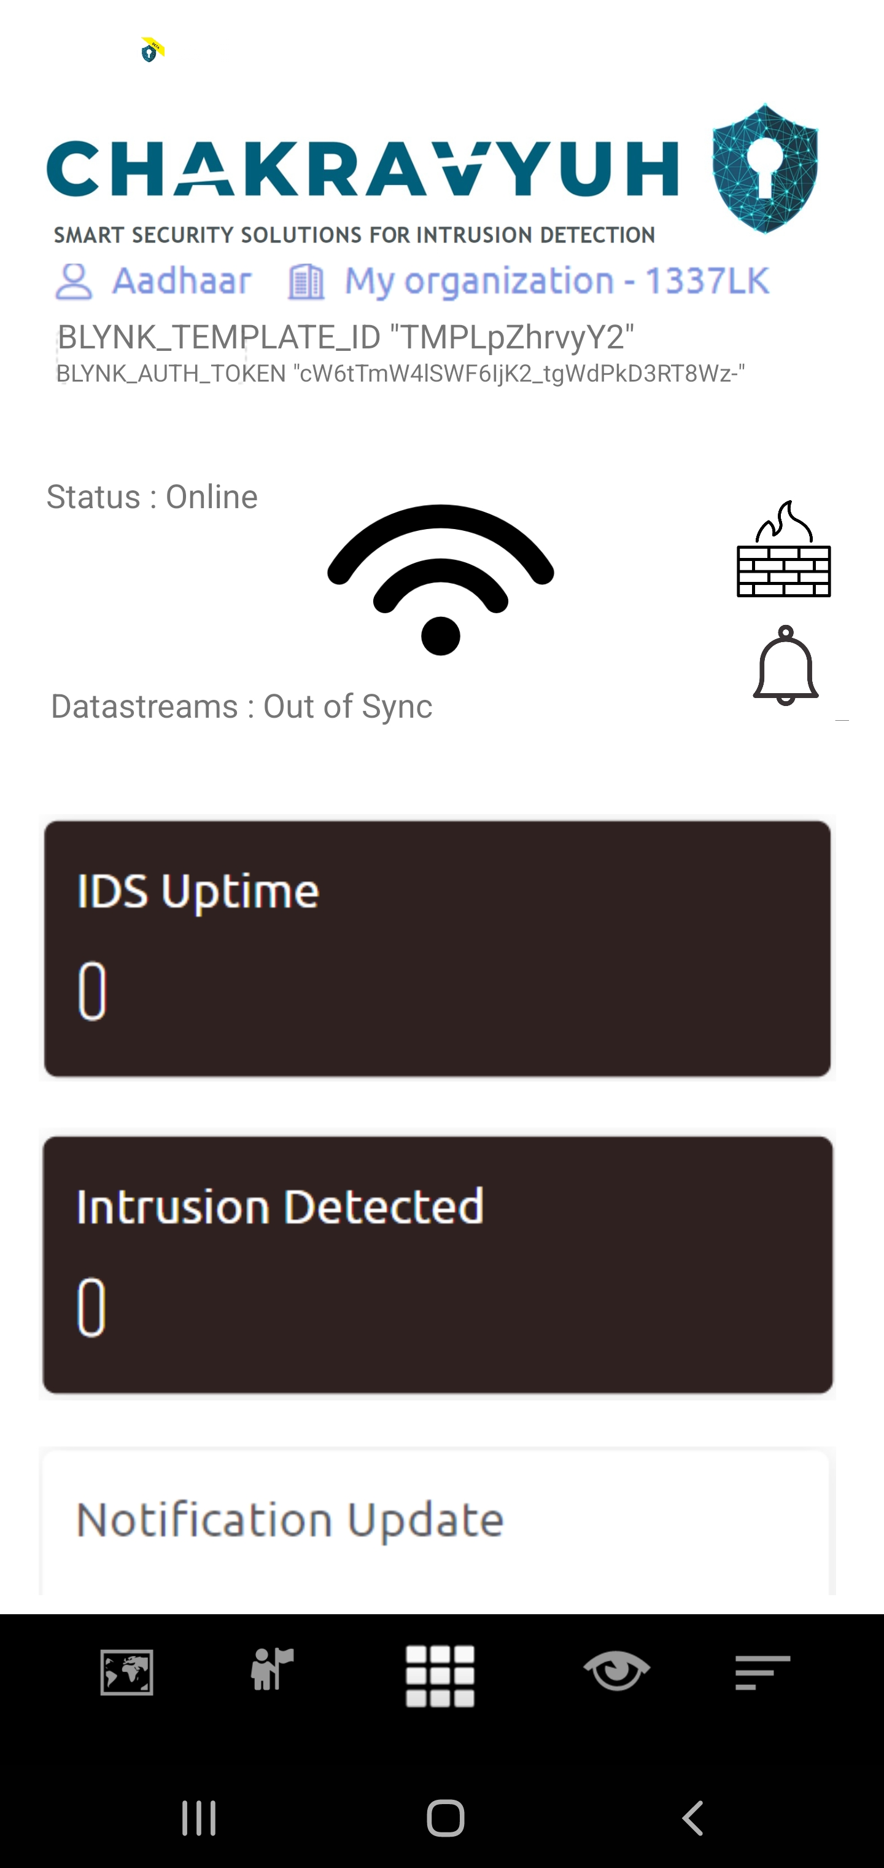
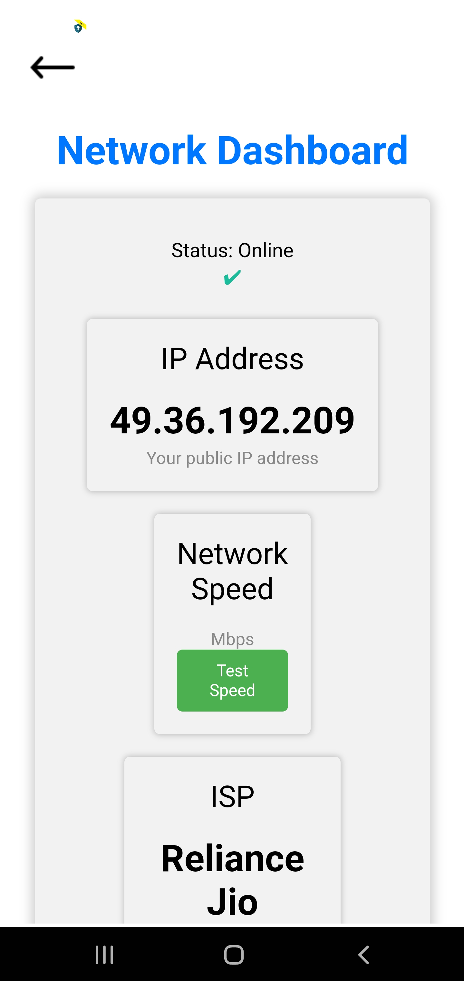
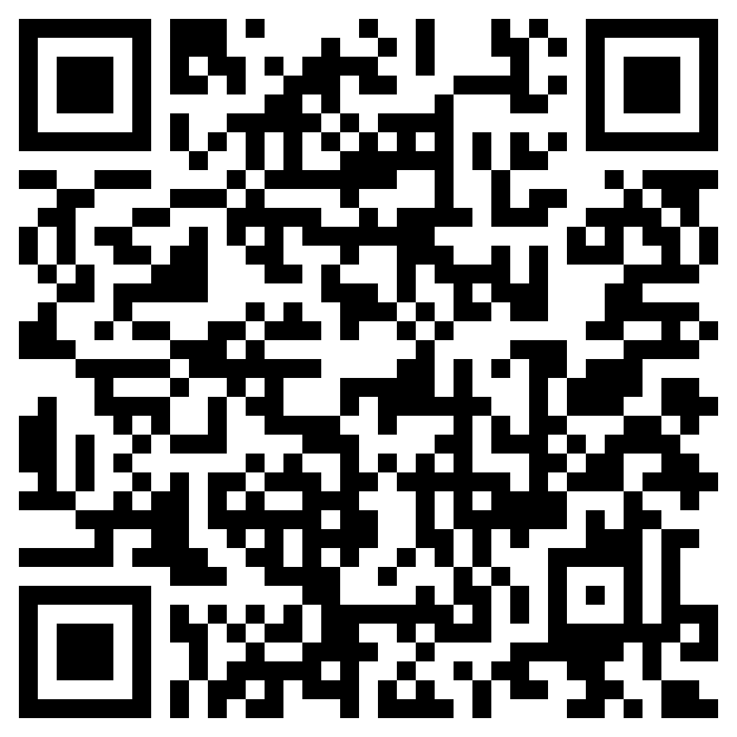
ADMIN CONTROL APPLICATION
Features
* Real time Sensor Readings
* Push Notificatrions
* Seamless Interface
* Admin Login Functioality
* Supported version of Android6.0 and Above
* Analytical report Dashboard
* Remote access functionality
* AR control Functionality
Test it Out on your device:

Slide 21
Target Market
General Public
Government Agencies
Companies / Enterprises
Large Scale Industries
Small scale Industries

Slide 22
Direct Competitors
Indirect Competitors
CylancePROTECT
McAfee Host IPS
Cisco IDS/ IPS
CrowdStrike Falcon
Check Point Firewall

Slide 23
DEMONSTRATION

Slide 24



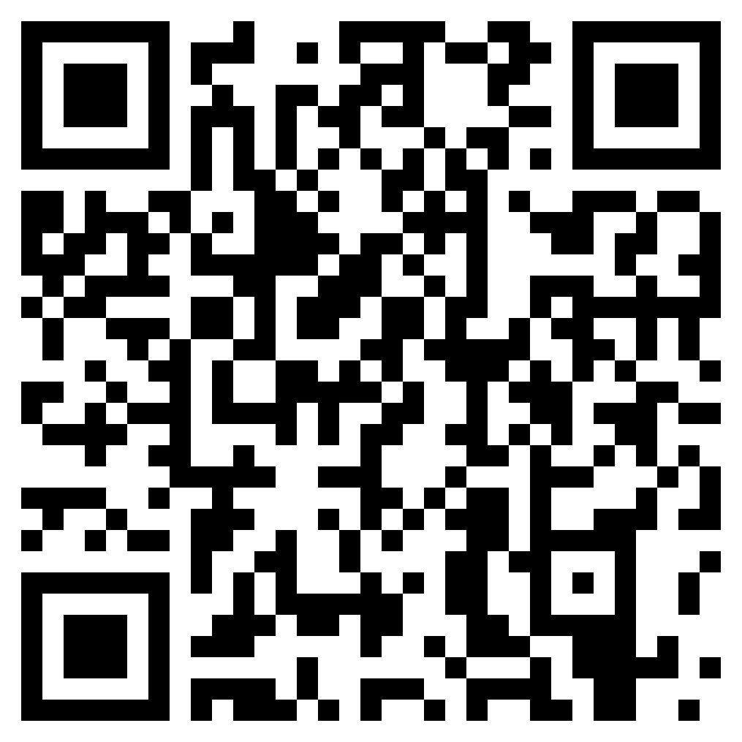
DEPLOYMENTS

Slide 25
Step 1
Increased Use of AI and Machine Learning
Future Roadmap
What are your next steps and goals? How much support do you need from investors, and what will it get you?
Step 2
Integration with Cloud- Based Security
Step 3
Expansion of IoT Security
Step 4
Embeded AR functionality

Slide 26




Meet our Team
Aadhaar Koul
Networking & IoT Engineer
Baseer Fatima
IoT , Cloud & Integrations Engineer
Arjun Charak
AI/ML & AR Engineer
Navneet Kaur
IoT , Cloud & Integrations Engineer

Slide 27
QUESTIONS ?

Slide 28
THANK YOU

